Slide 1
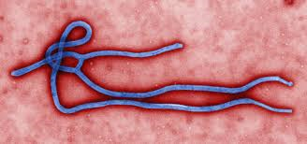
Ebola Preparedness- HIT Opportunities and Challenges
David Yi, MD
Chief Medical Information Officer
Virginia Hospital Center
Arlington, Virginia
November 21, 2014

Slide 2
Objectives
Review hospital specific preparations
Discuss key HIT challenges related to hospital Ebola preparedness
HIT opportunities

Slide 3
History
Notes:
Discovered 19786
Town near the ebola river
There are 6 variants of the ebola virus
Reservoir is unknown

Slide 4
HIT RELATED CHALLENGES FOR EBOLA PREPAREDNESS

Slide 5
http://www.nbcbayarea.com/news/national-international/Texas-Hospital-Software-Blame-Ebola-Patients-Misdiagnosis-277988141.html

Slide 6
What did we do to prepare?
Notes:
What are some of the key steps that occurred at VHC.
I wont get to deep in any one area.
Leave time at end for questions
Established Ebola Task force.(composed)
Revise clinical workflow and screening assessments (initially in ed)
Determine protocols and procedures (ever changing)
Worked closely with local public health departments.
Communicate and Train users(not easy, ppe)
Build infrastructure, computers, communication
Ebola “drills”(learn new things)
Everything else! Supply management, access control, communication, disposal

Slide 7
Key Steps that Occurred at VHC
Establishment of Ebola Task Force
Revision of Clinical workflow and screening assessments (initially in ED)
Determination of protocols and procedures (ever-changing)
Communication and training of users (PPE)
Collaborate with local and state Public Heath Departments
Ebola “Drills”
Everything Else
Supply Management
Access Control
Communication
Waste Disposal

Slide 8
Communication Challenges
Why is it so difficult?
Not much published evidence
Dependent on experts to make recommendations
Hospitals took initial steps (given limited experience and knowledge of ebola) to the best of their ability based on available published guidelines and guidance from ID specialists
Recommendations change frequently
Careful wording necessary to avoid panic and misinterpretation
Uniform message delivery
Notes:
Not much published evidence.
Dependent on experts to make recommendations, these change frequently
Hospitals took initial steps to the best of their ability based on available published and internal guidance from infectious disease specialists.
Need to word carefully to avoid misinterpretation and panic
Need to have uniform message go out

Slide 9
VHC Specific Steps - Communication
Screening questions formulated in a way that is easy to carry out
Common logon messages that are visible to all
Common location with static links to updated intranet resources
Electronic resources consolidated onto single page with attention to maintain working links
Patient can communicate to family or clinicians outside room using tablet PCs.

Slide 10
Procedure Challenges
Biggest risk in healthcare facility is ensuring adequate training and compliance to very specific procedures with all aspects of patient care
Ensuring adherence with correct PPE donning/doffing (ie, gloves)
Procedure demonstrations, video recording, feedback
Buddy system
Overcome physical tethers for exam equipment, stethoscope
Pagers, phones for communication
Notes:
Large umber of users, shift work, may not come back day to day
Verrry specific procedures to follow when donning and doffing.
Type of PPE changes over time

Slide 11
VHC Specific Steps - Procedures
Update procedures as new info is available
Perform testing drills, learn gaps
Leverage tablets/phones for communication with patient
New stethoscopes
Essential guidelines and checklists left easily accessible on paper
Posted on carts, taped on doors
PPE donning/doffing
Notes:
Change in gowning

Slide 12
Documentation Challenges
We often try to “hardwire” a workflow change using a documentation requirement. That’s a problem when it comes to screening!
Caution necessary in over-reliance on making a system change
Timing of documentation might be different than expected
Multiple entry points for patients
Often existing clinical workflows have maintained existence out of habit, magnifying complexity of clinical EHRs since they attempt to mimic existing workflows
EHRs not effectively utilized for decision support
Notes:
Often we “hardwire” a workflow using a documentation requirement. That’s a problem
EHR changes must be implemented in concert with non-IT workflows

Slide 13
VHC Specific Steps - Documentation
Simple scripted screening phrases developed first staff who encounters patient. Realize this may be documented afterwards.
3 EHR systems were updated in concert with similar screening questions.
Notes:
Change in gowning

Slide 14
HIT RELATED Opportunities FOR EBOLA PREPAREDNESS

Slide 15
Opportunity #1 Eliminate Parallel workflows
“The chains of habit are too weak to be felt until they are too strong to be broken.”
― Samuel Johnson
Notes:
Go back to texas example
As EHRs mature, historic clinical workflows will need to change.

Slide 16
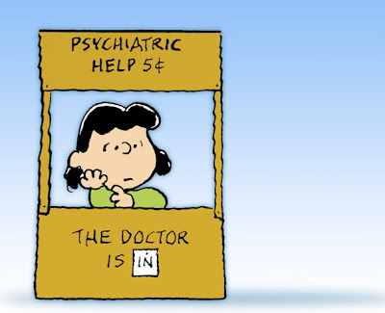
Opportunity #2 Reduce Documentation Requirements

Slide 17
Opportunity #3 Anticipate the next “Ebola”
Clinical Devices.
Exam equipment
Personal Protective Equipment
EMR as a tool for screening
Establish effective communication tools
Notes:
Devices that can be effectively cleaned or alternatively disposed of
Look at the exam equipment needed to properly treat patients

Slide 18
Conclusions
Ebola preparedness presents a host of challenges in HIT
Ebola preparedness presents some opportunities for improvement by utilizing HIT
VHC has taken some key steps towards achieving Ebola preparedness
Due to the changing nature of policies and procedures relating to Ebola, achieving preparedness remains an ongoing endeavor
Requires ongoing collaboration with local state and national public health organizations

